Slide 1
C3: Classification
Dr. Chetana Gavankar, Ph.D,
IIT Bombay-Monash University Australia
Chetana.gavankar@pilani.bits-pilani.ac.in

Slide 2
Session 1
Date –06/06/2020
Time – 10 am to 12pm
These slides are prepared by the instructor, with grateful acknowledgement of Prof. Carlos Guestrin, Prof. Emily Fox and many others who made their course materials freely available online.

Slide 3
Session Content
Evaluation Plan
Introduction to Classification
Types of classification
Classification Algorithms covered in the course and type of these algorithms
Applications of Classification
Case study
Python implementation

Slide 4
Books
Text books and Reference book(s)
T1 | Christopher Bishop: Pattern Recognition and Machine Learning, Springer International Edition
T2 | Tom M. Mitchell: Machine Learning, The McGraw-Hill Companies, Inc.
R1 | An Introduction to Data Mining – Pang-Ning Tan, Michael Steinbach, Anuj Karpatne, Vipin Kumar
5 June 2020
Notes:
The requirements of information security within an organization have undergone two major changes in the last several decades. Before the widespread use of data processing equipment,the security of information felt to be valuable to an organization was provided primarily by physical (eg. rugged filing cabinets with locks) and administrative mechanisms (eg. Personnel screening procedures during hiring process).
Growing computer use implies a need for automated tools for protecting files and other information stored on it. This is especially the case for a shared system, such as a time-sharing system, and even more so for systems that can be accessed over a public telephone network, data network, or the Internet.
The second major change that affected security is the introduction of distributed systems and the use of networks and communications facilities for carrying data between terminal user and computer and between computer and computer. Network security measures are needed to protect data during their transmission.

Slide 5
Evaluation
Evaluation Component | Marks | Type
Comprehensive Examination | 40% | Closed
Quizzes (3) | 24% | Open
Assignments (4) | 36% | Open

Slide 6
Evaluation
Quiz-1 (Regular) | Module M1 and M2 | 14th June 2020 (09:00 PM - 09:30 PM)
Quiz-1 (Makeup) | Module M1 and M2 | 17th June 2020 (09:00 PM - 09:30 PM)
Quiz-2(Regular) | Module M3, M4 and M5 | 5th July 2020 (09:00 PM - 09:30 PM)
Quiz-2 (Makeup) | Module M3, M4 and M5 | 8th July 2020 (09:00 PM - 09:30 PM)
Quiz-3(Regular) | Module M6 and M7 | 19th July 2020 (09:00 PM - 09:30 PM)
Quiz-3 (Makeup) | Module M6 and M7 | 22nd July 2020 (09:00 PM - 09:30 PM)
Assignment-1 | KNN Implementation | 16th June, 2020 (Tuesday)
Assignment-2 | Naive Bayes and Logistic Regression | 23rd June, 2020 (Tuesday)
Assignment-3 | Decision Tree | 7th July, 2020 (Tuesday)
Assignment-4 | SVM | 26th July, 2020 (Sunday)

Slide 7
Regression vs Classification
In Regression we assign input vector x to one or more continuous target variables t
Linear regression has simple analytical and computational properties
In Classification we assign input vector x to one of K discrete classes Ck, k = 1, . . . ,K
Common classification scenario: classes considered disjoint
Each input assigned to only one class
Input space is thereby divided into decision regions

Slide 8
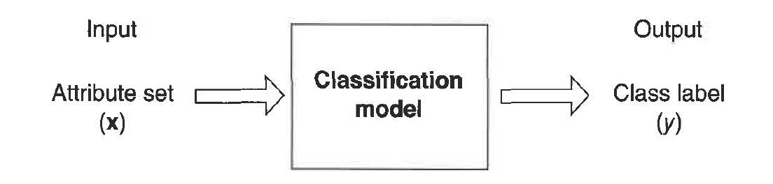
Introduction to Classification
Classification is the task of learning a target function f that maps each attribute set x to one of the predefined class Iabels y
Feature / Attribute – Input attribute that’s used in classifying the output
Feature set – Set of attributes that govern the output class
Label – Output class that the object is assigned to

Slide 9

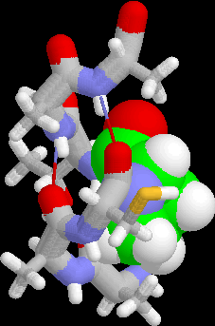
Examples of Classification Task
Predicting tumor cells as benign or malignant
Classifying credit card transactions as legitimate or fraudulent
Classifying secondary structures of protein as alpha-helix, beta-sheet, or random coil
Categorizing news stories as finance, weather, entertainment, sports, etc

Slide 10
Illustrating Classification Task

Slide 11
What We’ll Cover in this Course
Nearest-neighbour methods – kNN classifier
Naïve Bayes Classifier
Logistic Regression
Decision Tree
Optimization Foundations for Support Vector Machines
Support Vector Machines
Support Vector Machines in overlapping class distributions & Kernels
Ensemble Methods

Slide 12
Types of Classification
Non-probabilistic e.g, kNN
Probabilistic
Discriminative approach Ex: Logistic Regression
Generative approach Ex: Naïve Bayes
Discriminant Functions Ex: SVM
Tree-based Models Ex: Decision Tree

Slide 13
Non-probabilistic - Classification Using Distance
Place items in class to which they are “closest”.
Must determine distance between an item and a class.
Classes represented by
Centroid: Central value.
Medoid: Representative point.
Individual points
Algorithm: kNN

Slide 14
Non-probabilistic Classification (kNN)
k-Nearest Neighbour Classifier
Instance based classification
An object is assigned to the class most common among its k nearest neighbours
How to determine optimal k ?

Slide 15
K Nearest Neighbor (kNN)
Training set includes classes.
Examine K items near item to be classified.
New item placed in class with the most number of close items.
O(q) for each tuple to be classified. (Here q is the size of the training set.)

Slide 16
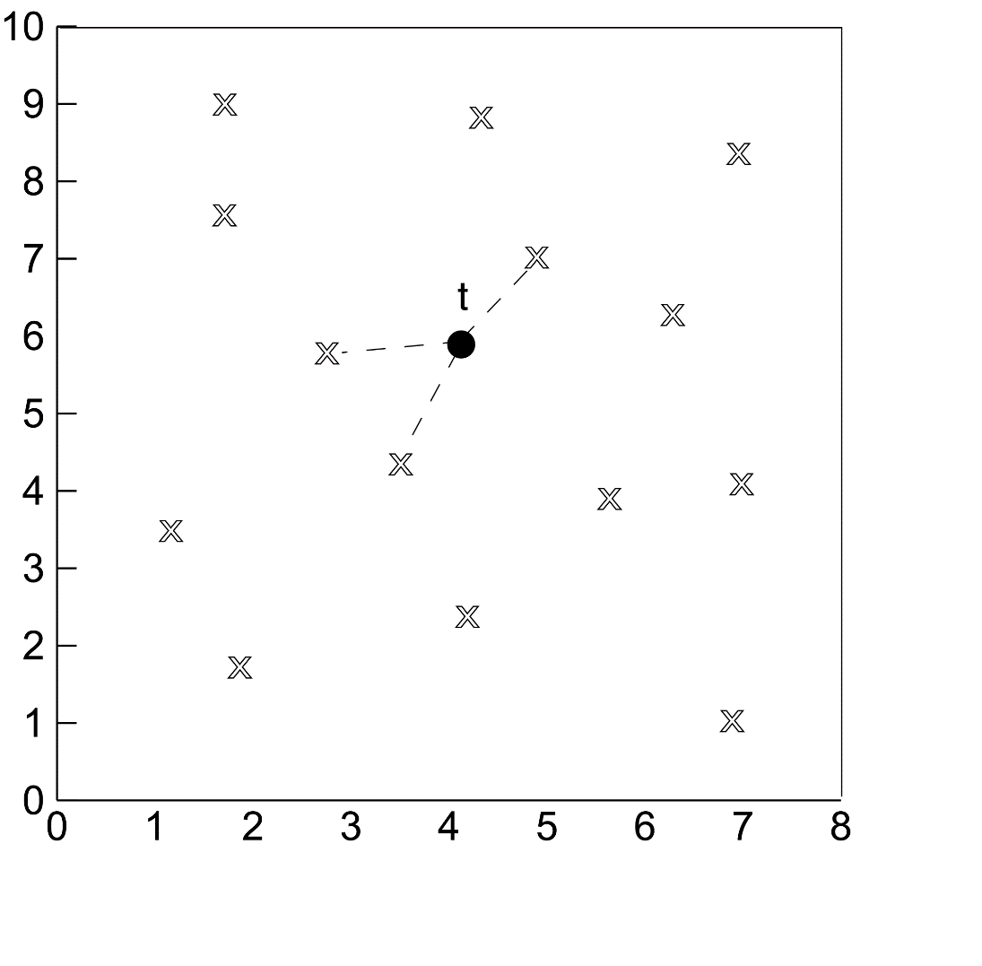
KNN

Slide 17
KNN applications
Despite its simplicity, KNN can outperform more powerful classifiers and is used in a variety of applications such as economic forecasting and genetics.

Slide 18
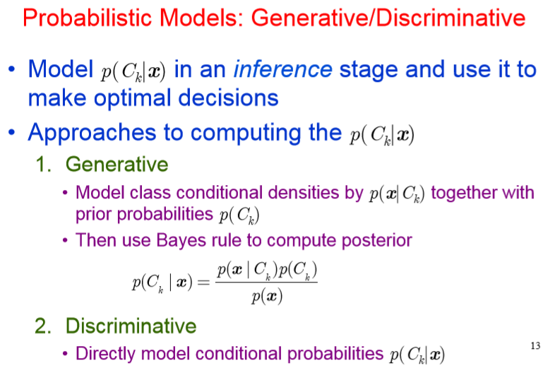

Slide 19
Probabilistic Generative Model versus Probabilistic Discriminative Model
Generative:
Discriminative:
x₂
x₂
Decision Boundary
x₁
x₁

Slide 20
Probabilistic Generative Model versus Probabilistic Discriminative Model
Generative Model | Discriminative Model
Derive joint probability distribution using training data | Derive conditional probability from training data
Requires considerably large training set to generate an decent model | Can work with moderate sized data as well, since the conditional probability is drawn from given input set directly
Models the actual distribution of each class | Models the decision boundary between classes
Use Bayesian theory to assign input to a class Ex: Naïve Bayes Model | Use maximum likelihood to assign an input to a class Ex: Logistic Regression
Probabilistic Generative Vs Probabilistic Discriminative Models

Slide 21
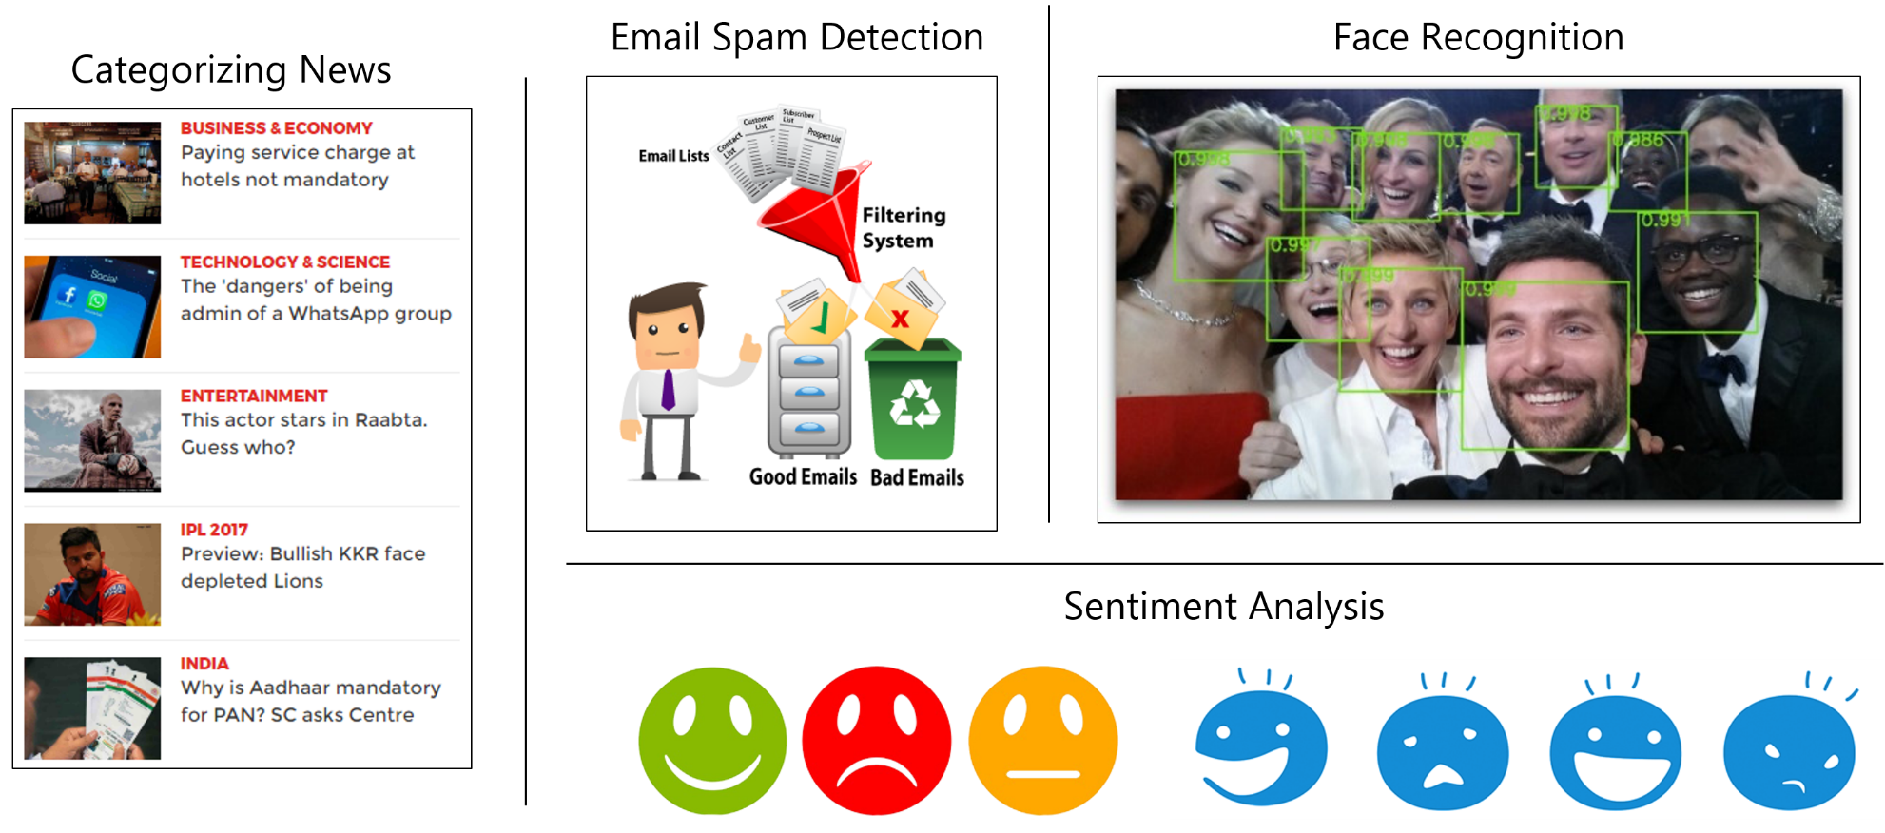
Naïve Bayes Classifier Applications

Slide 22
Naive Bayes Classifier
When to use
Moderate or large training set available
Attributes that describe instances are conditionally independent given classification
Successful applications:
Diagnosis
Classifying text documents

Slide 23
Learning to Classify Text
Why?
Learn which news articles are of interest
Learn to classify web pages by topic
Naive Bayes is among most effective algorithms
What attributes shall we use to represent text documents??

Slide 24


Slide 25

Baseline: Bag of Words Approach
aardvark 0
about 2
all 2
Africa 1
apple 0
anxious 0
...
gas
...
oil
… Zaire
1
1
0

Slide 26
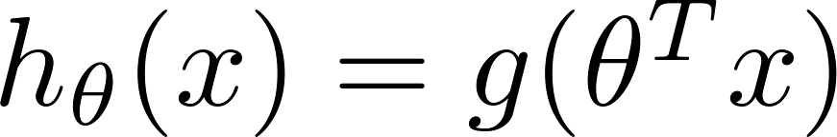
Logistic Regression
Sigmoid/logistic function takes a real value as input and outputs another value between 0 and 1
That framework is called logistic regression
Logistic: A special mathematical sigmoid function it uses
Regression: Combines a weight vector with observations to create an answer

Slide 27
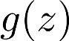
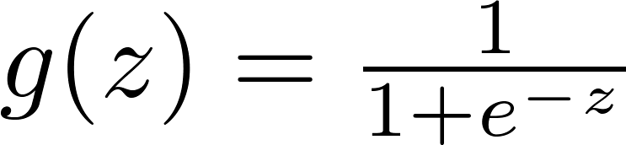
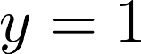
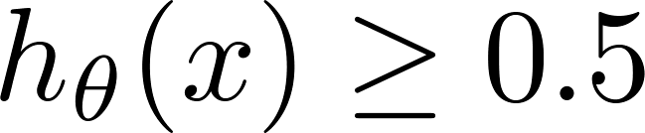
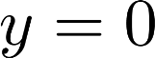
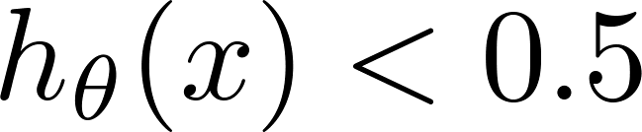
Logistic Regression
1
z
Suppose predict “ “ if
predict “ “ if

Slide 28
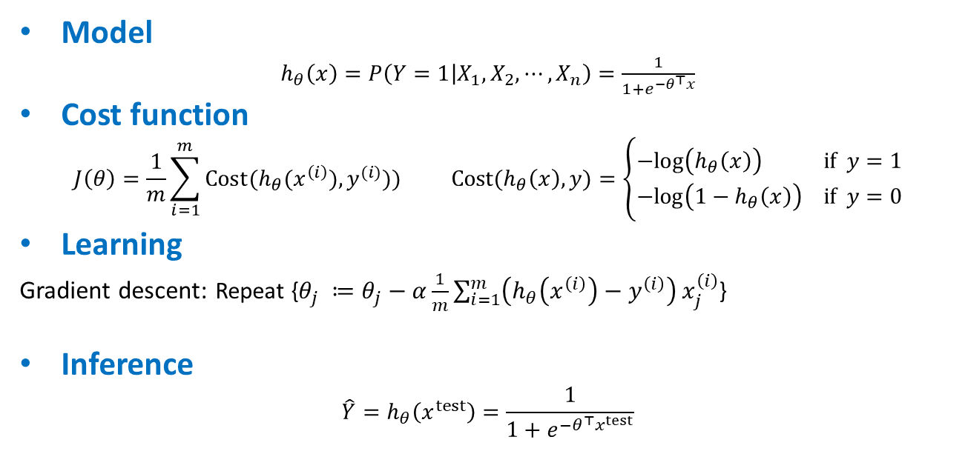
Logistic regression (Classification)
Model
$h_{θ}\left(x\right)=P\left(Y=1 | X_{1},X_{2}, ⋯, X_{n}\right)=\frac{1}{1+e^{−θ^{⊤}x}}$
Cost function
$$J\left(θ\right)=\frac{1}{m}\sum_{i=1}^{m}{Cost(h_{θ}(x^{\left(i\right)}),y^{(i)}))} Cost(h_{θ}\left(x\right),y)=\left\{\begin{aligned}−log\left(h_{θ}\left(x\right)\right) if y=1 \\ −log\left({1−h}_{θ}\left(x\right)\right) if y=0\end{aligned}\right.$$
Learning
Gradient descent: Repeat {$θ_{j} ≔θ_{j}−α\frac{1}{m}\sum_{i=1}^{m}{\left(h_{θ}\left(x^{\left(i\right)}\right)−y^{\left(i\right)}\right)}x_{j}^{\left(i\right)}$}
Inference
$$\hat{Y}=h_{θ}\left(x^{test}\right)=\frac{1}{1+e^{−θ^{⊤}x^{test}}}$$

Slide 29
Logistic Regression Applications
Credit Card Fraud : Predicting if a given credit card transaction is fraud or not
Health : Predicting if a given mass of tissue is benign or malignant
Marketing : Predicting if a given user will buy an insurance product or not
Banking : Predicting if a customer will default on a loan.

Slide 30
Naïve Bayes versus Logistic Regression
Naïve Bayes are Generative Models
Logistic Regression are Discriminative Models
Naïve Bayes easy to construct
Naive Bayes also assumes that the features are conditionally independent. Real data sets are never perfectly independent
When the training size reaches infinity, logistic regression performs better than the generative model Naive Bayes.
Optional reading by Ng and Jordan has proofs and experiments

Slide 31
Tree based Model - Decision Tree
Leaf represents class label
Decisions are (internal) nodes/ branches
Supervised learning for classification / regression
Can handle categorical and continuous data
Little preprocessing needed
Prone to overfitting
Pruning
Early stop of tree building

Slide 32
Example of a Decision Tree
categorical
categorical
continuous
class
Splitting Attributes
Refund
Yes
No
NO
MarSt
Single, Divorced
Married
TaxInc
NO
< 80K
> 80K
NO
YES
Training Data
Model: Decision Tree

Slide 33
Apply Model to Test Data
Test Data
Start from the root of tree.
Refund
Yes
No
NO
MarSt
Single
Married
TaxInc
NO
< 80K
> 80K
NO
YES

Slide 34
Apply Model to Test Data
Test Data
Refund
Yes
No
NO
MarSt
Single
Married
TaxInc
NO
< 80K
> 80K
NO
YES

Slide 35
Apply Model to Test Data
Test Data
Refund
Yes
No
NO
MarSt
Single
Married
TaxInc
NO
< 80K
> 80K
NO
YES

Slide 36
Apply Model to Test Data
Test Data
Refund
Yes
No
NO
MarSt
Single
Married
TaxInc
NO
< 80K
> 80K
NO
YES

Slide 37
Apply Model to Test Data
Test Data
Refund
Yes
No
NO
MarSt
Single
Married
TaxInc
NO
< 80K
> 80K
NO
YES

Slide 38
Apply Model to Test Data
Test Data
Refund
Yes
No
NO
MarSt
Single
Married
Assign Cheat to “No”
TaxInc
NO
< 80K
> 80K
NO
YES

Slide 39
Decision Tree Classification Task
Decision Tree

Slide 40
Support Vector Machines (SVM) – Linear classifier
Support Vector classifier – makes things better but not always
Hard-margin
Soft-margin

Slide 41
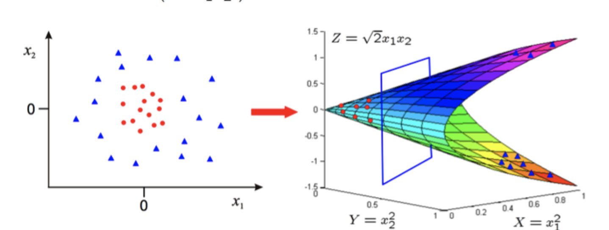
Support Vector Machines (SVM) – Non-linear classifier (kernel trick)
Transforms the feature space to allow fitment of a linear hyperplane
Polynomial
Radial basis function (rbf)
Hyperbolic Tangent (tanh)

Slide 42
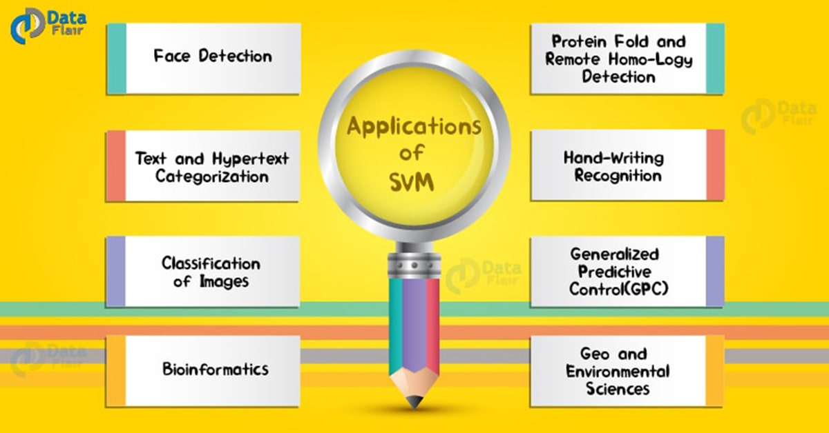
SVM Application

Slide 43
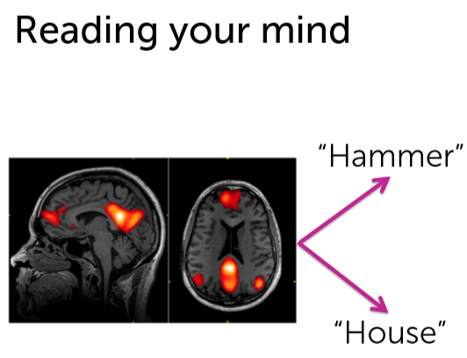
Brain Image Classification

Slide 44
Ensemble Methods
Bagging (Bootstrap AGGregating)
Boosting
AdaBoost (Adaptive Boosting)
XGBoost (eXtreme Gradient Boosting)
Random Forest

Slide 45
Ensemble Methods
Ensemble methods use multiple learning algorithms to obtain better predictive performance than could be obtained from any of the constituent learning algorithms alone
Construct a set of classifiers from the training data
Predict class label of test records by combining the predictions made by multiple classifiers
Tend to reduce problems related to over-fitting of the training data.

Slide 46
General Approach

Slide 47
When does Ensemble work?
Ensemble classifier performs better than the base classifiers when e is smaller than 0.5
Necessary conditions for an ensemble classifier to perform better than a single classifier:
Base classifiers should be independent of each other
Base classifiers should do better than a classifier that performs random guessing

Slide 48
Applications of Classification – Medical domain
Tumour classification – Malignant Benign (image based)
Risk prediction for Diabetes, Heart disease, Alzheimer’s etc.
Image courtesy: Google AI blog

Slide 49
Applications of Classification – Finance
Determining credit worthiness rating of corporates in lending
Determine stock worthiness of the portfolio (buy/don’t)
Fraud detection in bulk transactions (stocks/loans etc.)

Slide 50
Applications of Classification – ecommerce
Product Recommendations
Smart search engines
– image search
Warehouse automation
Sales forecasting
Inventory forecast
Dynamic pricing and price bundling

Slide 51
Applications of Classification – Case Study Overview
Diabetes Mellitus prediction in women
Two-class problem (yes/no classification)
Data set – 768 patients with health records and family history as parameters
Input attribute set
Pregnancies
Glucose
Blood Pressure
Skin Thickness
Insulin
BMI
Age
Label - Outcome (diabetic or non-diabetic)

Slide 52
Applications of Classification – Case Study Overview
Predict presence of Liver disease in a patient based on vitals
Two-class problem (yes/no classification)
Data set – Data 583 patients with health parameters
Input attribute set
Age
Gender
Bilirubin (total & direct)
Alkaline Phosphatase
Alamine Aminotransferase
Aspartate Aminotransferase
Total Proteins
Albumin
Albumin & Globulin Ratio
Label
Outcome (liver disease present or not)

Slide 53
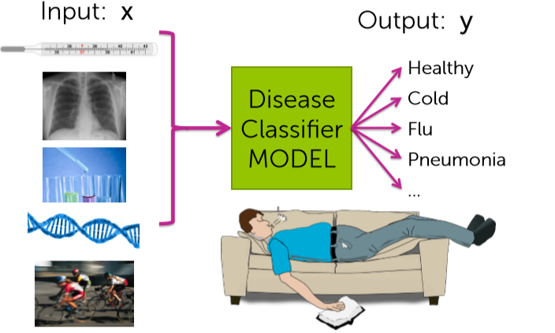
Case study: Personalized medical diagnosis

Slide 54
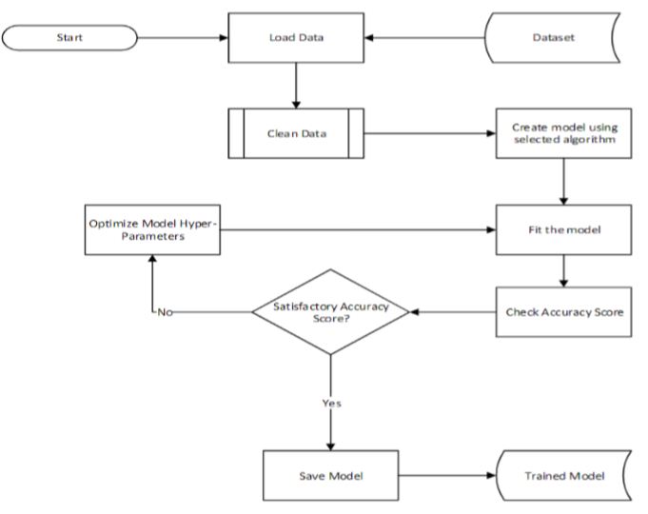
Case study: Training Model

Slide 55
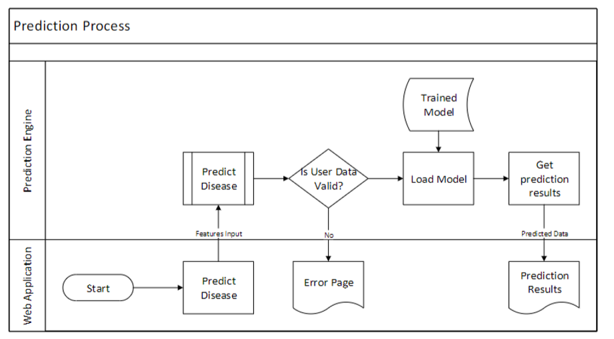

Slide 56
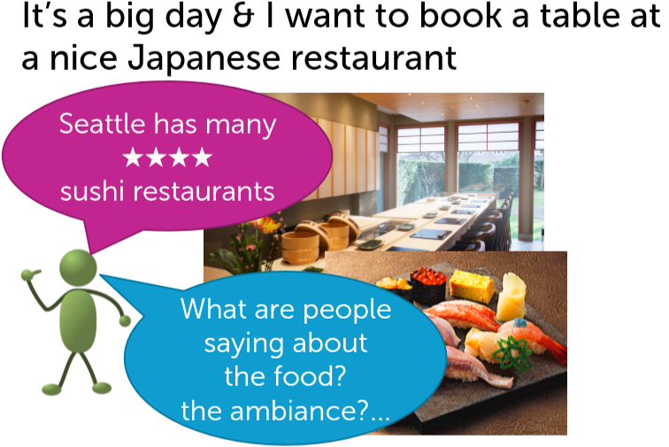
Case study: Sentiment Analysis

Slide 57
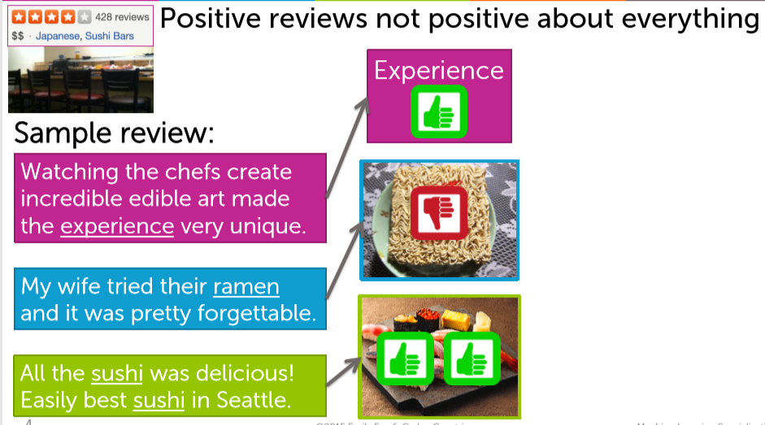
Case study: Sentiment Analysis

Slide 58
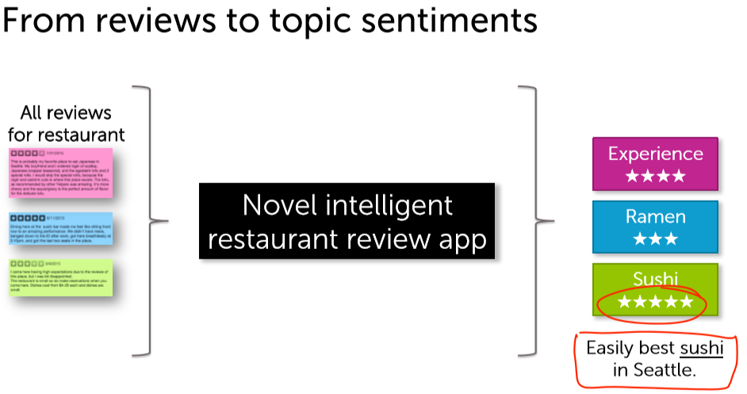
Case study: Sentiment Analysis

Slide 59
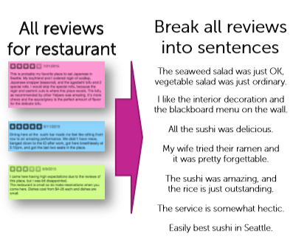
Case study: Sentiment Analysis

Slide 60
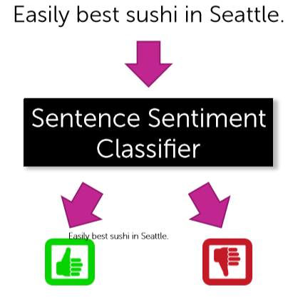
Case study: Sentiment Analysis

Slide 61
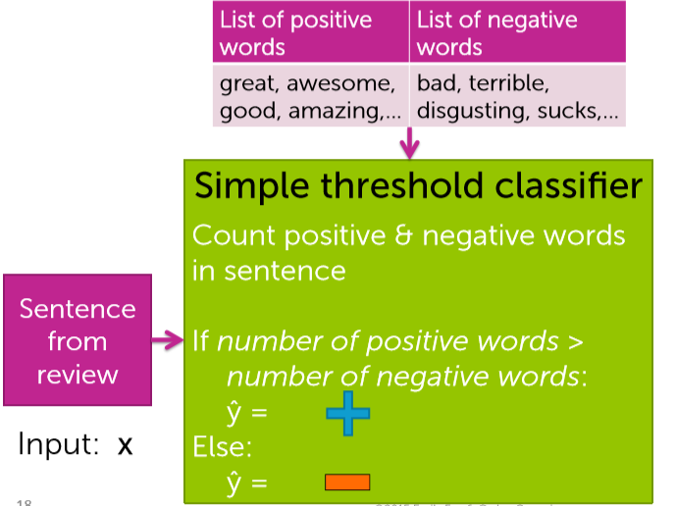
Case study: Sentiment Analysis

Slide 62
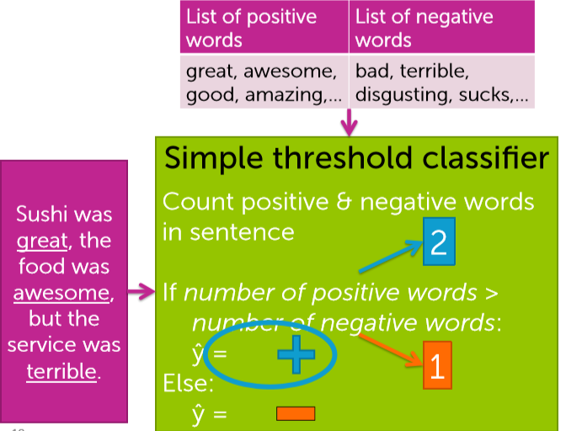
Case study: Sentiment Analysis

Slide 63
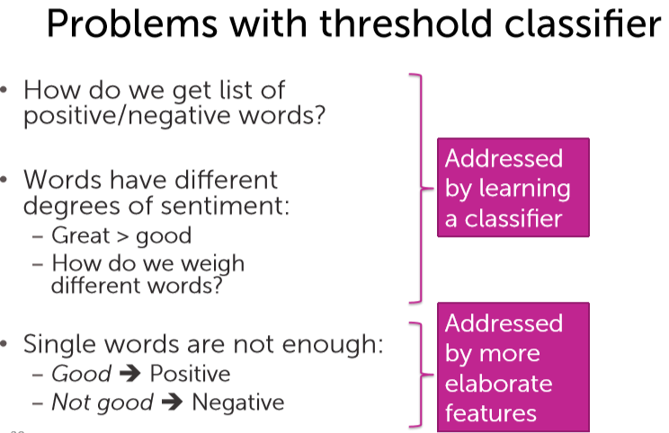
Case study: Sentiment Analysis

Slide 64
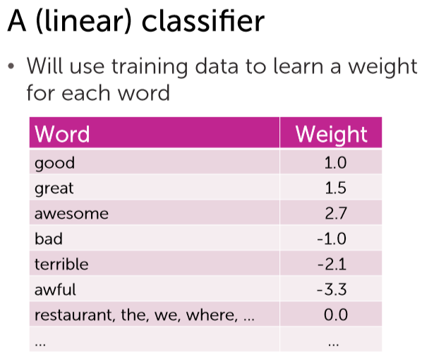
Case study: Sentiment Analysis

Slide 65
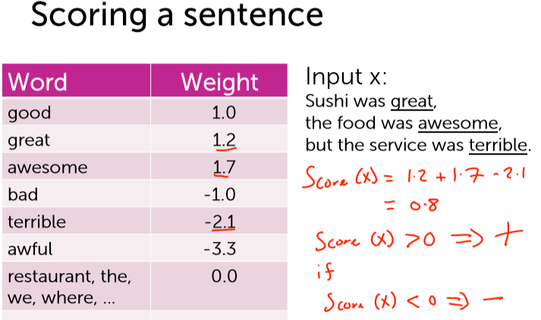
Case study: Sentiment Analysis

Slide 66
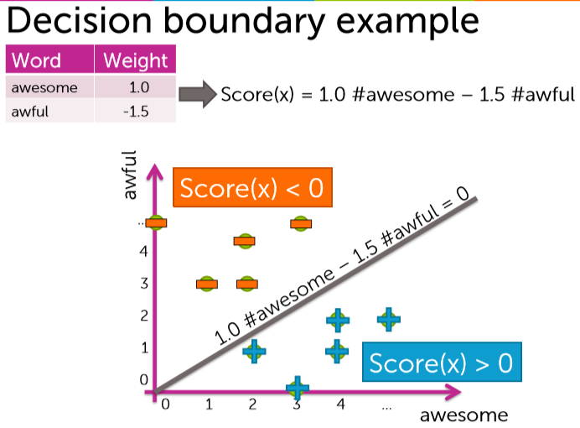
Case study: Sentiment Analysis

Slide 67
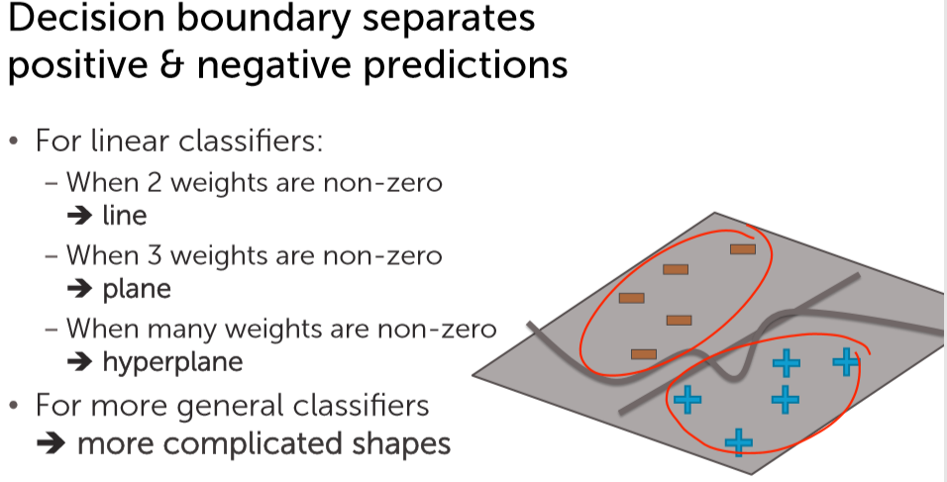
Case study: Sentiment Analysis

Slide 68
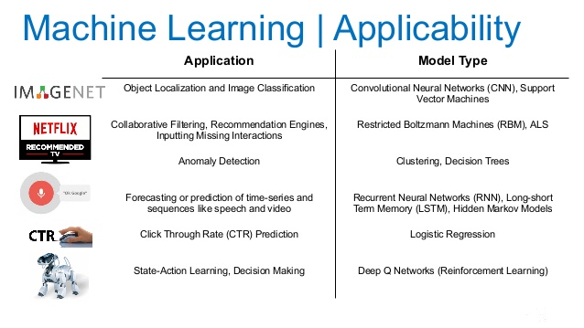
Machine Learning Model Selection

Slide 69
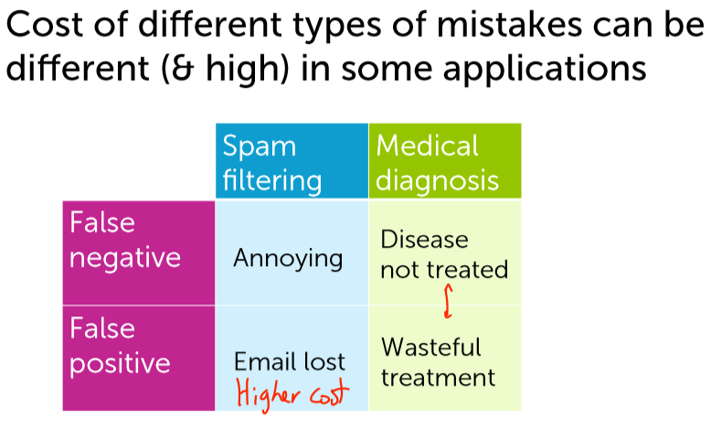
Machine Learning Model Selection

Slide 70


Slide 71
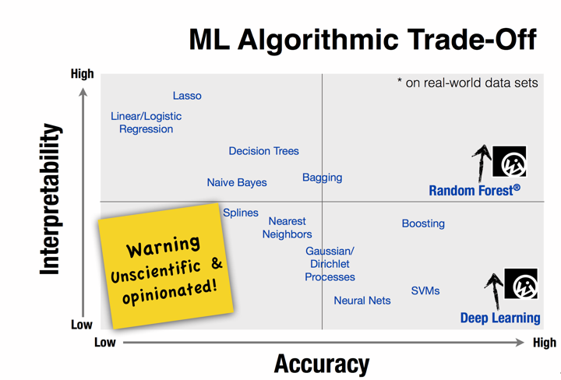

Slide 72
ML algorithm selection
Practical advice is:
Define a performance metric to evaluate your model
Ask yourself: What performance score is desired, what hardware is required, what is the project deadline
Start with the simplest model
If you don't meet your expected goal, try more complex models

Slide 73
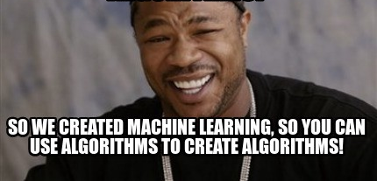
You like Algorithms?

Slide 74
References
https://www.coursera.org/learn/ml-foundations/?action=enroll#syllabus
http://ai.stanford.edu/~ang/papers/nips01-discriminativegenerative.pdf
https://medium.com/@sangha_deb/naive-bayes-vs-logistic-regression-a319b07a5d4c
https://www.dezyre.com/article/top-10-machine-learning-algorithms/202
https://towardsdatascience.com/top-10-machine-learning-algorithms-for-data-science-cdb0400a25f9
https://towardsdatascience.com/simple-guide-for-ensemble-learning-methods-d87cc68705a2
https://towardsdatascience.com/building-a-k-nearest-neighbors-k-nn-model-with-scikit-learn-51209555453a
https://scikit-learn.org/stable/modules/generated/sklearn.linear_model.LogisticRegression.html

Slide 75
References
https://hackernoon.com/choosing-the-right-machine-learning-algorithm-68126944ce1f
https://sebastianraschka.com/blog/2018/model-evaluation-selection-part4.html
https://scikit-learn.org/stable/tutorial/machine_learning_map/index.html
https://machinelearningmastery.com/a-gentle-introduction-to-model-selection-for-machine-learning/
https://www.coursera.org/learn/ml-foundations/?action=enroll#syllabus
https://www.coursera.org/learn/ml-classification/lecture/N7QA6/multiclass-classification-with-1-versus-all

Slide 76
Thank You
5 June 2020

